Slide 1



COC - Oracle Database Administration Fundamentals for SAP
– strictly confidential, confidential, internal, public –
3/12/2019
1

Slide 2
Course Objectives
  Overview of database data storage model and file architecture
  Archiving process
  Using Database Administration Tools – brtools, sql plus
  Space Management
  Administrating Oracle Instances
  Introduction to SQL
  SAP DB Monitors basics
  Reorganization of segments
  Backup restore scenario
  Troubleshooting of logs files

Slide 3
Overview of Database
UNIT CONTENTS
  Database Architecture
  Environment Variables
  Connecting to the database

Slide 4
Overview of Database
Database Architecture – Basic Terms
  Instance
  Active part of a database server
  It's a combination of Oracle (background) processes and memory buffers
  Every running Oracle database is associated with an Oracle instance

Slide 5
Overview of Database
Database Architecture – Basic Terms
  Database
  Passive part of a database server
  It's a collection of data, logically treated as a unit
  It consists of 3 file types (data files, control files, redo log files)
  Physically, the data is stored in one or more data files on disks.
  Oracle manages database data in logical unites called tablespaces. A tablespace consists of one or more data files.

Slide 6
Overview of Database
Database Architecture
SAP
Processes
SHADOW
Background processes
SHADOW
SHADOW
DBW0
LGWR
ARC0
CKPT
PMON
SMON
Memory area
System Global Area (SGA)
Program Global Area
(PGA)
Shared pool
Large pool
Large pool
…
Java pool
Database buffer cache
Redo buffer
…
Database files
Profile
Control file
Data files
Online redo log files
Offline redo log files

Slide 7
Overview of Database
Listener
  Its responsibility is to listen for incoming connection requests and it forwards the requests to the server
  Once a connection is established, the client and Oracle database server communicate directly with one another
  The listener is configured with a protocol address; only clients configured with the same protocol address can send connection requests to listener
  For checking a connection to the listener, there is a tool: tnsping

Slide 8
Overview of Database
Listener
  $ORACLE_HOME/network/admin
  listener.ora
  tnsnames.ora
  sqlnet.ora
Database server
SAP application server
SAP Work process
SAP Work process
SAP Work process
OracleNet
TCP/IP
Oracle
listener
OracleNet
TCP/IP
SAP Work process
Shadow
Shadow
tnsnames.ora
sqlnet.ora
listener.ora
Shadow
tnsnames.ora
sqlnet.ora
listener.ora
Notes:
listener.ora
listener.ora configures the listener and, as such, is only used on the database
host. It is read when the listener is started. The configuration information
specified in this file determines OracleNet settings, such as the network
protocol to be used, host name, port, and the default tracing information.
listener.ora must contain all Oracle system IDs and protocol addresses for
which the listener should accept connection requests.
tnsnames.ora
tnsnames.ora contains a list of service names for all databases that can be
accessed in the network.
sqlnet.ora
sqlnet.ora can contain client side information, such as a client domain to
append to unqualified service names or net service names, or

Slide 9
Overview of Database
Listener - managing
  LSNRCTL> help
  The following operations are available
  An asterisk (*) denotes a modifier or extended command:
  start stop status
  services version reload
  save_config trace spawn
  change_password quit exit
  set* show*
Notes:
listener.ora
listener.ora configures the listener and, as such, is only used on the database
host. It is read when the listener is started. The configuration information
specified in this file determines OracleNet settings, such as the network
protocol to be used, host name, port, and the default tracing information.
listener.ora must contain all Oracle system IDs and protocol addresses for
which the listener should accept connection requests.
tnsnames.ora
tnsnames.ora contains a list of service names for all databases that can be
accessed in the network.
sqlnet.ora
sqlnet.ora can contain client side information, such as a client domain to
append to unqualified service names or net service names, or

Slide 10
Overview of Database
Oracle Directories and Environment Variables
Server
ORACLE_SID: <DBSID>
ORACLE_HOME
SAPDATA_HOME
dbs
bin
network /
admin
sapdata1
sapdata<n>
oraarch
sapbackup
These tree environment variables
must always be set on
the database server for users
<sid>adm and ora<sid>
sapcheck
saparch
saptrace
sapreorg

Slide 11
Overview of Database
Oracle Directories and Environment Variables
  Displays environment variables
  env
  Sets an environment variable to requested value (sh and ksh shells)
  export <env_variable>=<value>
  or (csh shell)
  set <env_variable> <value>
  sets an environment variable to requested value
  Displays value of ORACLE_HOME environment variable
  echo $ORACLE_HOME

Slide 12
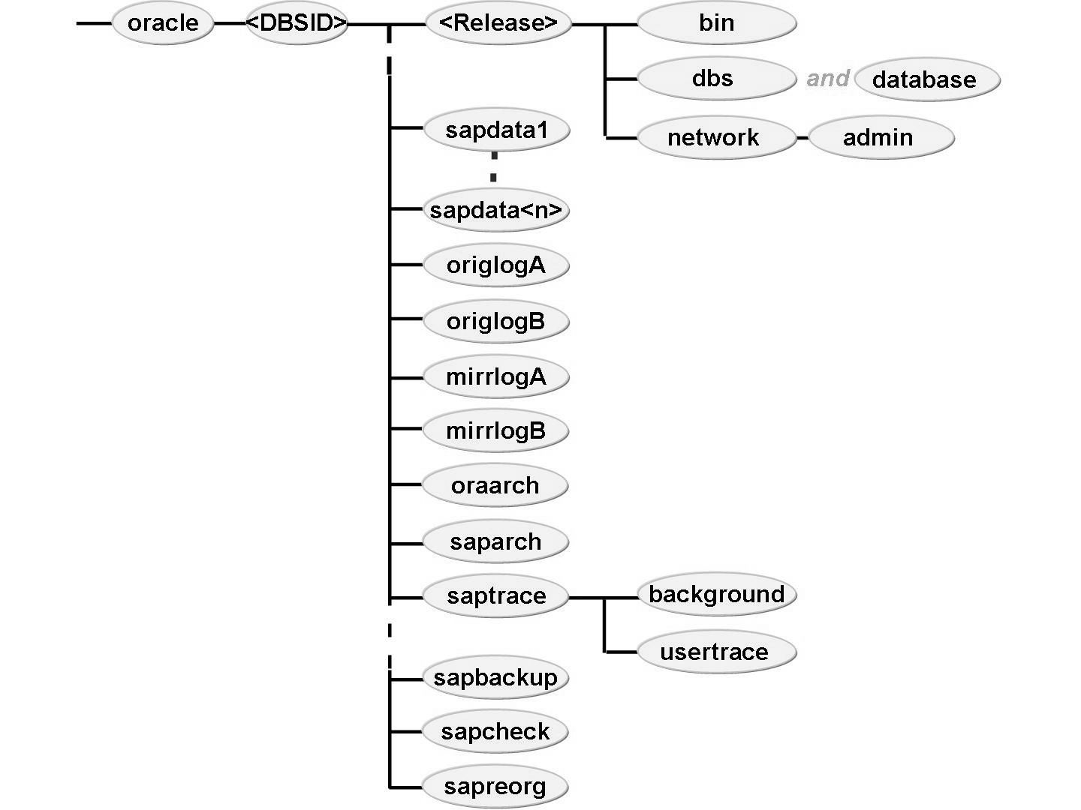
Overview of Database
Oracle Directory Structure in SAP
  The Oracle directory (folder) and file names are standardized in SAP environments.
  Directories (folders) are always created with the same structure and naming convention during the installation.
  This structure may not be changed, and the naming conventions must be observed, as SAP tools for Oracle administration rely on it.

Slide 13
Overview of Database
Oracle Directory Structure in SAP
  dbs
  The Oracle profile init<DBSID>.ora or spfile<DBSID>.ora holds the Oracle instance configuration parameters
  The profile init<DBSID>.sap holds configuration parameters for administration tools BR*Tools
  sapdata<n>
  Contains the data files of the tablespaces

Slide 14
Overview of Database
Oracle Directory Structure in SAP
  origlogA/B, mirrlogA/B
  Online redo log files reside in the origlog and mirrlog directories:
  Log file numbers 1 and 3 and their mirrors in origlogA and mirrlogA, log file numbers 2 and 4 and their mirrors in origlogB and mirrlogB, respectively
  oraarch
  Offline redo log files are written to the oraarch directory; their names are specified with help of Oracle instance configuration parameters, so the name <DBSID>arch1_<LSN>.dbf is just an example.

Slide 15
Overview of Database
Logging of Modifications
Redo Log buffer
Online redo log files
Archivepool

Slide 16
Overview of Database
Oracle Directory Structure in SAP
  saptrace
  Oracle dump files are written in the directory saptrace. The Oracle alert log alert_<DBSID>.log occurs in the directory background. Traces of Oracle shadow processes are written to the directory usertrace.
  saparch
  Stores the logs written by the SAP tool BRARCHIVE
  sapbackup
  Stores logs written by the SAP tools BRBACKUP, BRRESTORE, and BRRECOVER

Slide 17
Overview of Database
Oracle Directory Structure in SAP
  sapreorg
  BRSPACE creates logs for its different functions here
  sapcheck
  BRSPACE creates logs for its different functions here

Slide 18
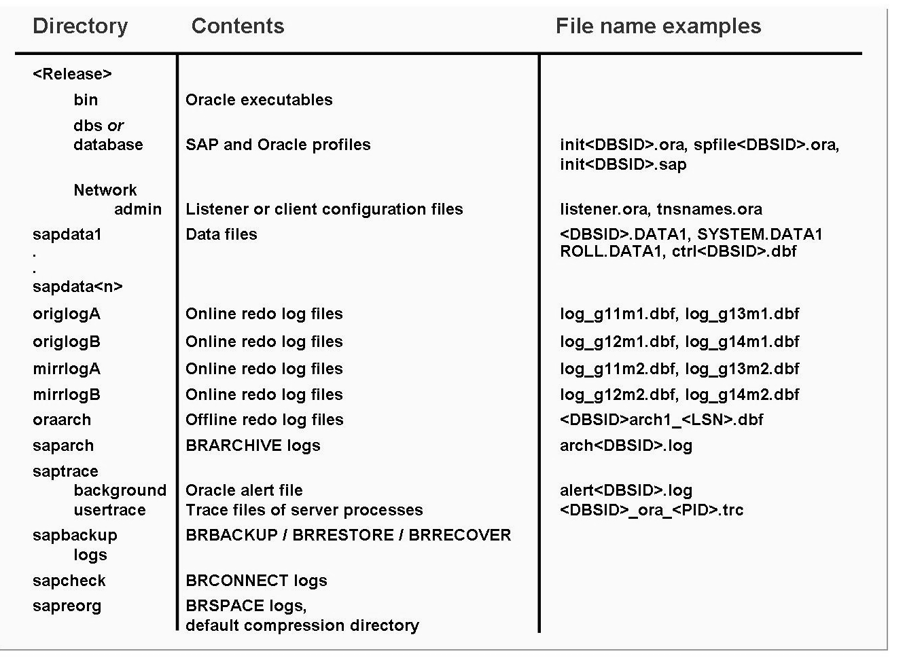
Overview of Database
Oracle Directory Structure in SAP

Slide 19
Overview of Database
Control file
  Every Oracle database has a control file. A control file is a small binary file that records the physical structure of the database and includes:
  The database name
  Names and locations of associated datafiles and online redo log files
  The timestamp of the database creation
  The current log sequence number
  Checkpoint information
  Location of the control file is configured in Oracle profile init<SID>.ora

Slide 20
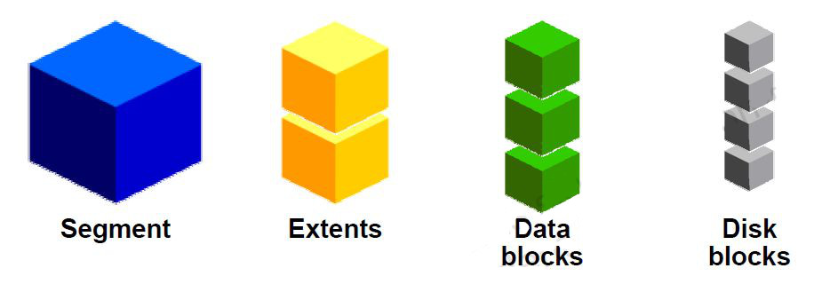
Overview of Database
Logical and Physical Database Structures
  Logical structure
  Database
  Tablespace
  Segment – Table / Index
  Extent
  Data block
  Physical structure
  Datafile
  Disk block

Slide 21
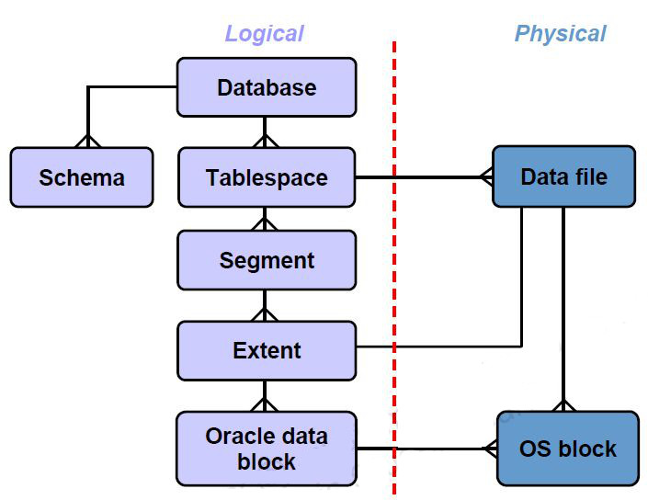
Overview of Database
Logical and Physical Database Structures

Slide 22

Database Administration Tools
Oracle Administration Tools on OS level
  BRTOOLS
  SQLPLUS
  BRGUI
  Enterprise Manager
  SQL Developer

Slide 23
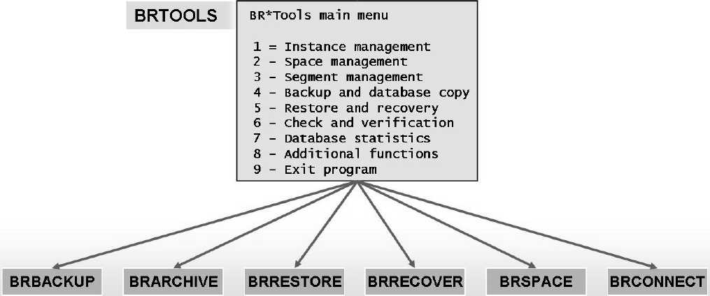
Database Administration Tools
BRTOOLS
  BRTOOLS is provided as a character-based user interface for the functional programs:
  BRBACKUP
  BRARCHIVE
  BRRESTORE
  BRRECOVER
  BRSPACE
  BRCONNECT
Notes:
SAP provides the tools BRBACKUP, BRARCHIVE, BRRESTORE, BRRECOVER, BRSPACE, BRCONNECT, and BRTOOLS to manage and protect the data in your Oracle database.

Slide 24
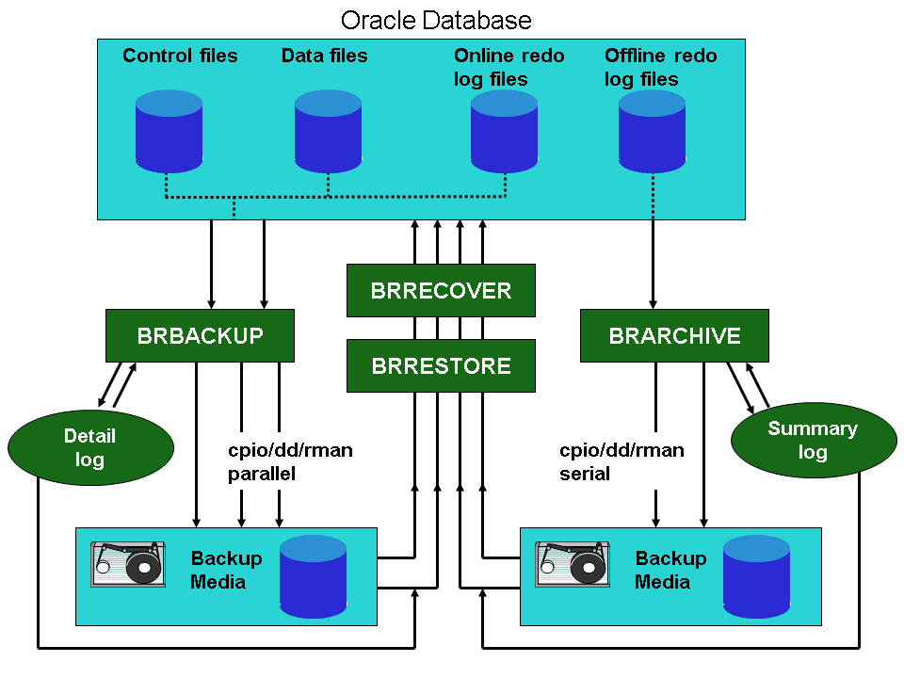
Database Administration Tools
BRTOOLS - Menu Structure

Slide 25
Space Management
Tablespaces
  Oracle stores data logically in tablespaces and physically in datafiles associated with the corresponding tablespace
  Possible actions on tablespace
  Resize Extend / Shrink
  Add
  Change autoextend properties
  Set offline
  Drop

Slide 26
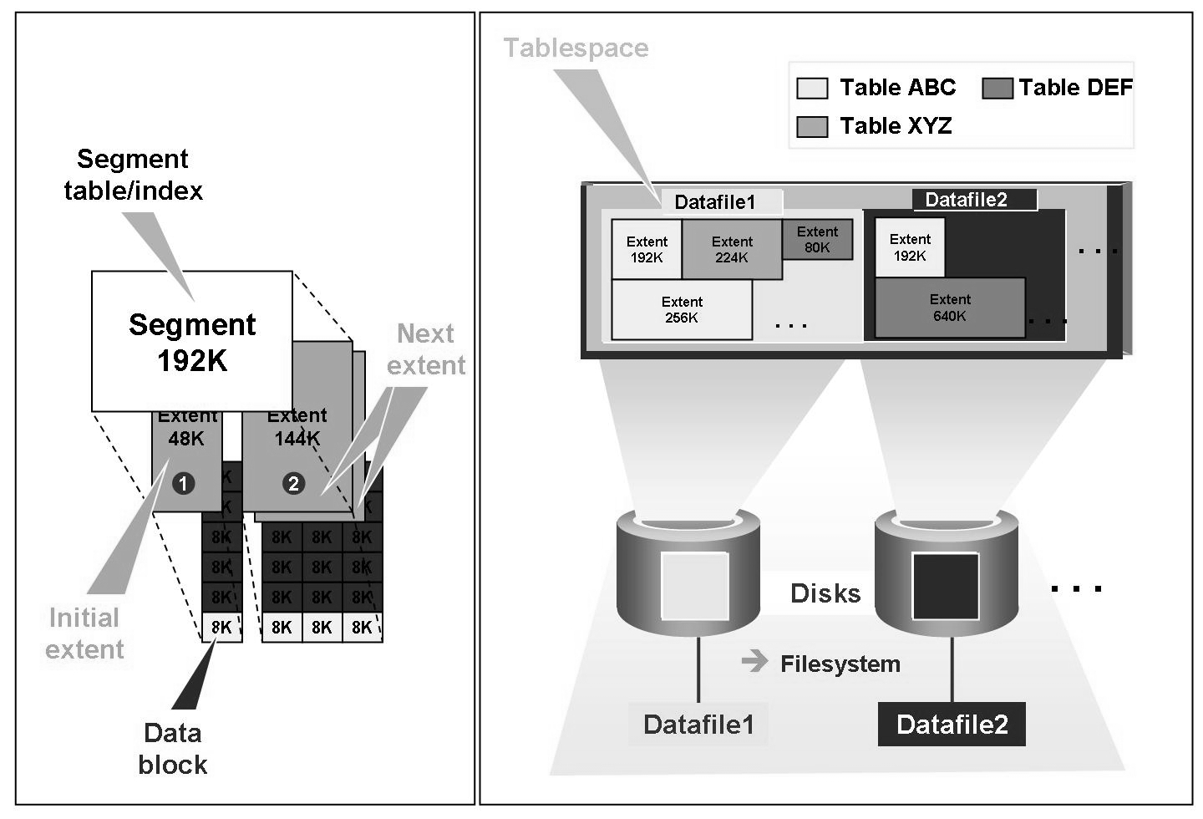
Space Management
Tablespaces Storage Parameters

Slide 27
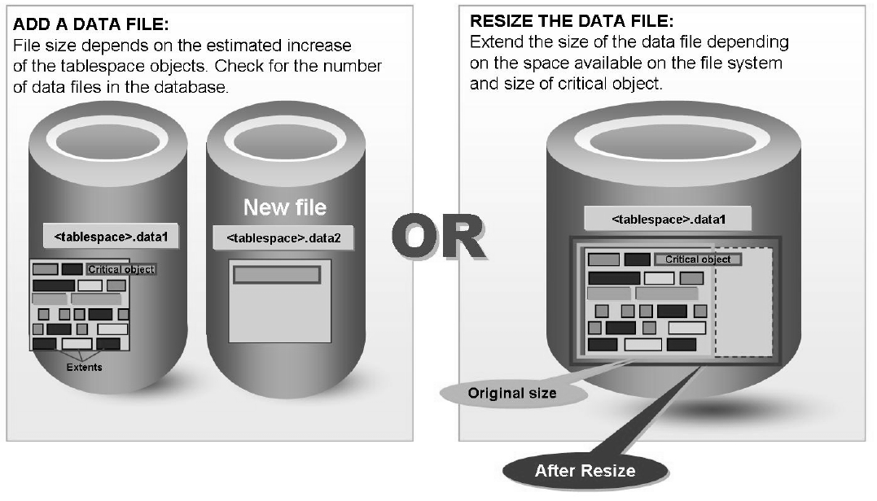
Space Management
Enlarging a Tablespaces

Slide 28
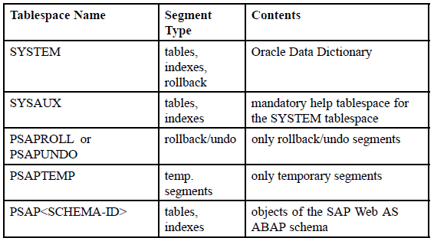
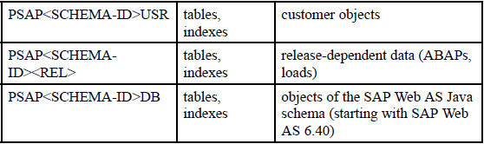
Space Management
Tablespaces - Naming Conventions

Slide 29
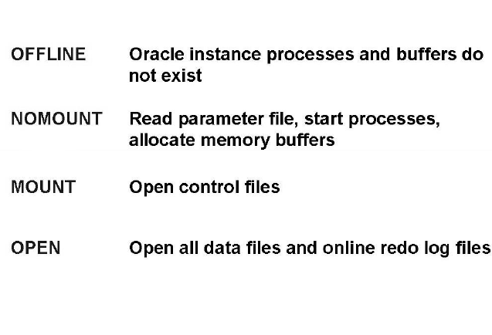
Administrating Oracle Instances
Statuses of an Oracle Instance / Startup options

Slide 30
Administrating Oracle Instances
Statuses of an Oracle Instance - NOMOUNT
  NOMOUNT
  In the NOMOUNT phase, the parameter file is opened and evaluated, and the database instance is started. Operating system resources are allocated using configuration information stored in the parameter file.

Slide 31
Administrating Oracle Instances
Statuses of an Oracle Instance - MOUNT
  MOUNT
  In the MOUNT phase, the control files of the database are opened (using the value of parameter CONTROL_FILES from the parameter file) and evaluated. The system reads the information about the physical structure of the database. Although data files and log files are not yet opened, parts of the data dictionary are loaded, so V$ views are available. If one or more of the files specified by the CONTROL_FILES initialization parameter does not exist or cannot be opened when you attempt to mount a database, Oracle returns an error message and does not mount the database.

Slide 32
Administrating Oracle Instances
Statuses of an Oracle Instance - OPEN
  OPEN
  In the OPEN phase, all remaining files of the database system are opened. If required, an instance recovery is performed during opening the database. Only when the database is open can valid database users connect to the database. If one or more of the data files or redo log files is not available or cannot be opened when attempting to open a database, Oracle returns an error message and does not open the database.

Slide 33
Administrating Oracle Instances
Statuses of an Oracle Instance / Startup options
  The NOMOUNT state is necessary for creating a database and for re-creating lost control files.
  The MOUNT state is needed for database recovery, for changing the ARCHIVELOG mode, for renaming (moving) data files, and for adding, dropping, or renaming online redo log files.

Slide 34
Administrating Oracle Instances
Statuses of an Oracle Instance / Shutdown options
  NORMAL
  No new connections are allowed. Oracle waits for all currently connected users to disconnect from the database. Only after the last user has disconnected (in SAP system: all work processes have been stopped), Oracle shuts down the database: all files are closed, the database is dismounted, and the instance is shut down.
  TRANSACTIONAL
  After this instruction has been defined, no new connections or new transactions are allowed. Oracle waits for all open transactions to finish, then it disconnects all database connections and shuts down the database.

Slide 35

Administrating Oracle Instances
Statuses of an Oracle Instance / Shutdown options
  IMMEDIATE
  No new connections are allowed, and no new transactions are allowed to be started after the statement is issued. The PMON process ends all user sessions and performs a rollback of any open transactions. Then the database is shut down.
  ABORT
  No new connections are allowed, and no new transactions are allowed to be started after the statement is issued. All client SQL statements currently being processed are terminated, without rolling back open transactions. User connections are disconnected and Oracle processes are stopped.

Slide 36
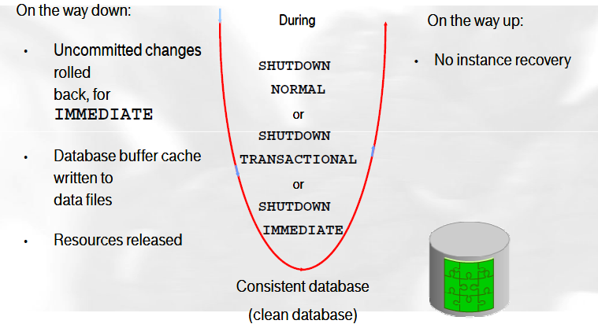
Administrating Oracle Instances
Statuses of an Oracle Instance / Shutdown options

Slide 37
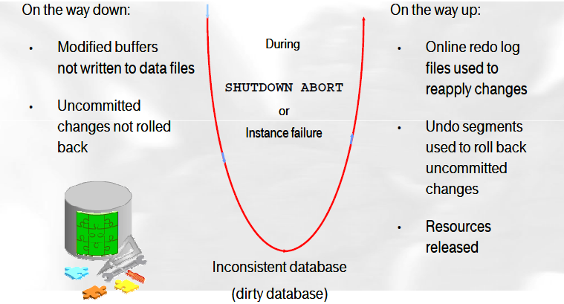
Administrating Oracle Instances
Statuses of an Oracle Instance / Shutdown options

Slide 38
Introduction to SQL
SQLplus
  With the Oracle tool SQL*Plus, you can:
  Start and stop the database
  Log into the database
  Perform database administration
  Enter SQL*Plus commands to configure an SQL*Plus environment
  Enter, edit, store, retrieve, and run SQL commands and SQL scripts
  Redirect the output of query results to text files

Slide 39
Introduction to SQL
SQL commands
  SQL commands by type
  DML – SELECT, INSERT, UPDATE, DELETE, MERGE
  DDL – CREATE, ALTER, DROP, RENAME, TRUNCATE, COMMENT
  DCL – GRANT, REVOKE
  TCL – COMMIT, ROLLBACK, SAVEPOINT
Notes:
Data Manipulation Language
Data Definition Language
Data control language
Transaction Control Language

Slide 40
Introduction to SQL
SQL commands
  sqlplus / as sysdba
  Basic syntax
  SELECT <COLUMN> from <SCHEMA>.<TABLE> where <COLUMN>='<condition>';
  UPDATE <SCHEMA>.<TABLE> set <COLUMN>=<value> where <COLUMN>='<condition>';
  DELETE from <SCHEMA>.<TABLE> where <COLUMN>='<condition>';

Slide 41
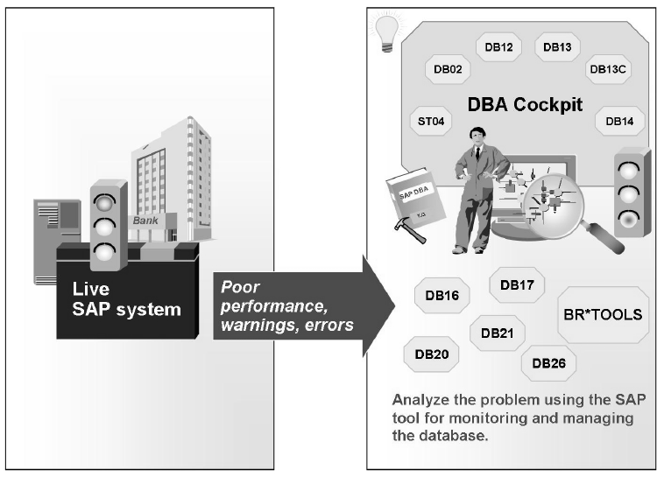
SAP DB Monitors basics
DB12, DB13, DB02…

Slide 42
SAP DB Monitors basics
DB13
  The DBA Planning Calendar and the central DBA planning calendar (transaction DB13 and DB13C) is available for scheduling backups and other
  administrative jobs in your database system. You can use this transaction to schedule backups and administrative activities locally or centrally for several SAP systems and databases.

Slide 43
SAP DB Monitors basics
DB12, DB14
  You can use the Backup Log Overview (transaction DB12) to display the results of your backups and the status of the archive directory. If all backups are available for a restore and recovery, it also contains a function for checking the restore reports.
  The DBA Operations Monitor (transaction DB14) checks the status and logs of all database operations, including backup monitoring, updates of the optimizer statistics, and database checks.

Slide 44
SAP DB Monitors basics
ST04, DB02
  The Database Performance Monitor (transaction ST04) displays the most important indicators for Oracle database performance – such as buffer cache quality, statistics of user calls or number of block reads per SQL statement – and the configuration of the database management system and the database,
  either directly through showing current parameter values or with help of V$ views.
  •The Tables and Indexes Monitor (transaction DB02) monitors the storage behavior of the database (for example, space statistics showing the history of the database, or size and free space in each tablespace) and the status of the database objects (for example size of each table in kilobytes and blocks, or indexes that are defined in the ABAP Dictionary but missing in the database).

Slide 45
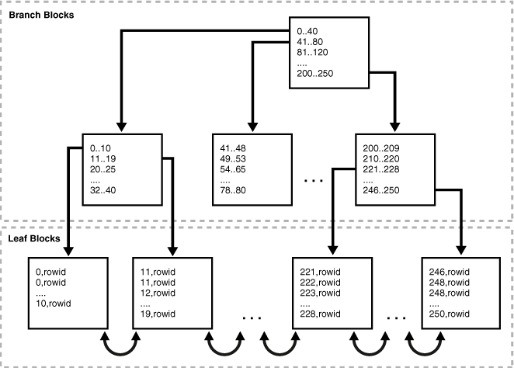
Database index
  Indexes are schema objects that are logically and physically independent of the data in the objects with which they are associated. Thus, an index can be dropped or created without physically affecting the table for the index.

Slide 46
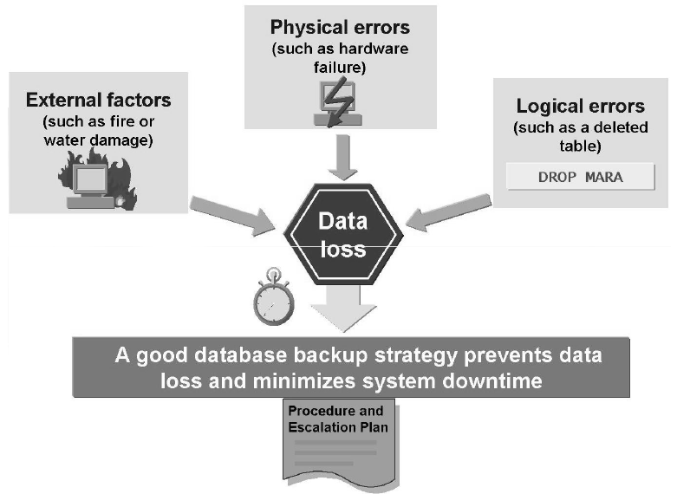
Administrating Oracle Instances
DB Backup

Slide 47
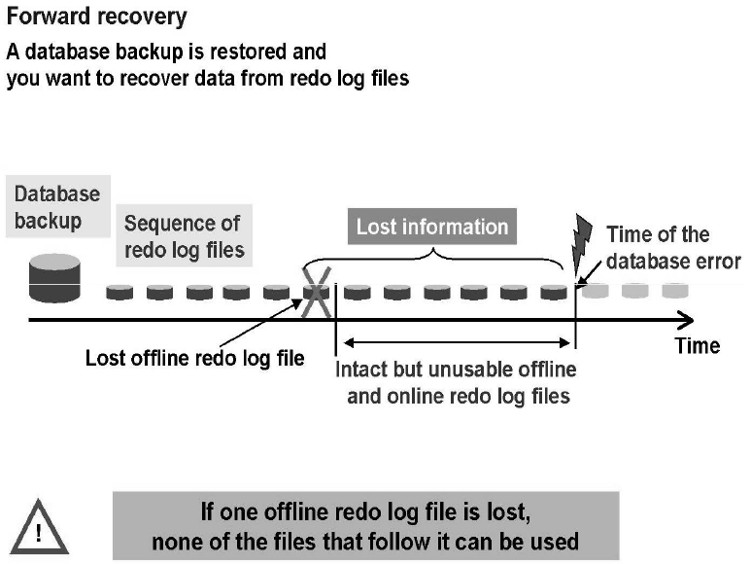
Administrating Oracle Instances
DB Backup

Slide 48
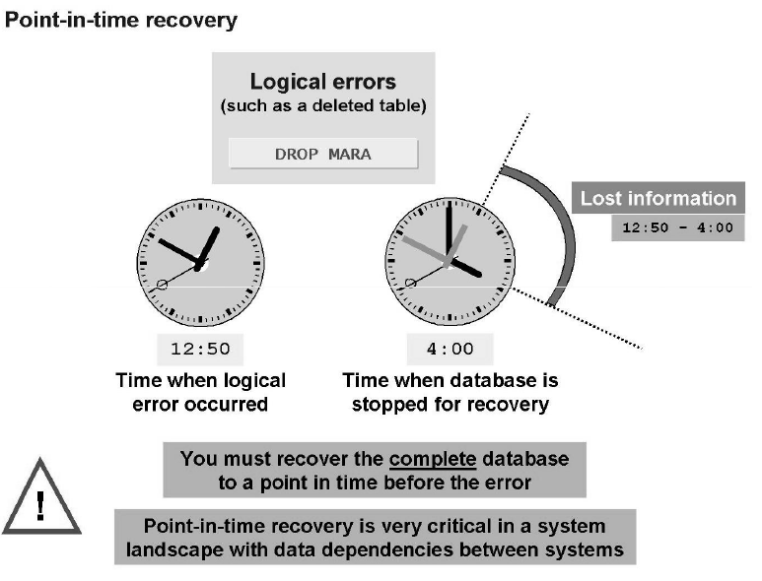
Administrating Oracle Instances
DB Backup

Slide 49
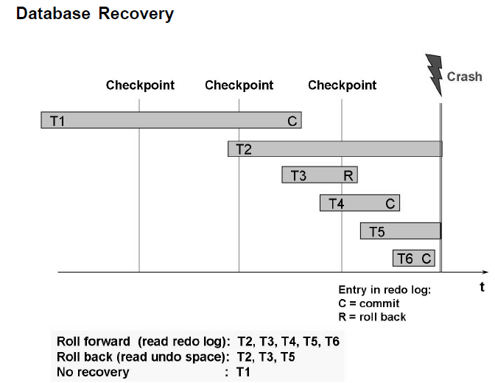
Administrating Oracle Instances
DB Recovery

Slide 50
Troubleshooting
Log files
  Backup log
    /oracle/<SID>/sapbackup/*.afd
  Redologs backup log
    /oracle/<SID>/saparch/arch<SID>.log
  Alert log
    11g / 12c
    /oracle/<SID>/saptrace/diag/rdbms/<sid>/<SID>/trace/alert_<SID>.log
    10g
    /oracle/<SID>/saptrace/background/alert_<SID>.log

Slide 51
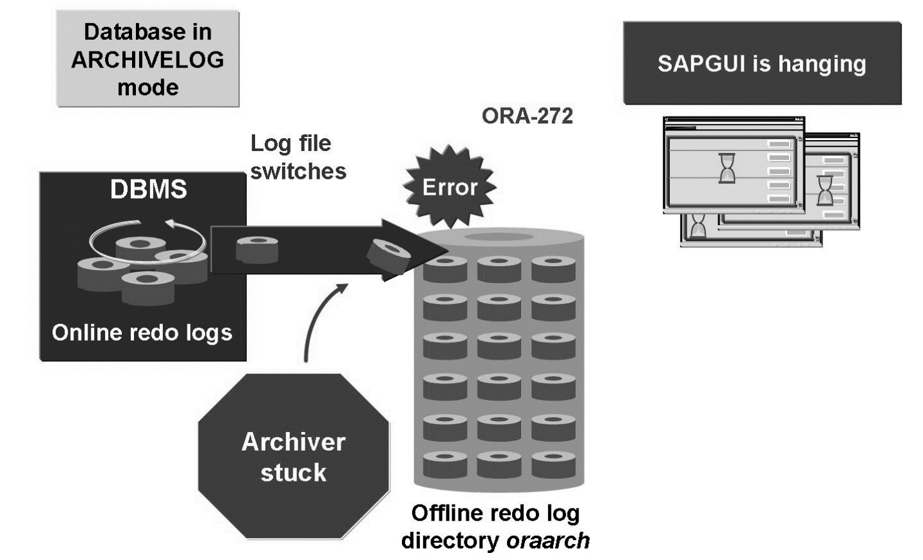
Troubleshooting
Archiver Stuck
  An archiver stuck is a situation in which the archiver instance process cannot copy an online redo log file to the archive directory (oraarch) and the online redo log file to be copied needs to be overwritten by the log writer (LGWR).

Slide 52

Oracle DBA
For SAP
– strictly confidential, confidential, internal, public –

